Slide 1
Discussion Unit:
Introduce DSE JMX
What does DSE Core JMX offer
Why use DSE Core JMX
DSE Core, JMX, What and Why
Notes:
The goal of this Discussion Unit is introduce DSE Core, and the what and why of JMX.

Slide 2
Discussion Lab:
DSE Core JMX, DSE (Interfaces/Utilities)
Matching pairs – Match the attributes on the right with the areas on the left
Notes:
On the next page we enter a Discussion Lab.

Slide 3


Discussion Lab: Which uses JMX
CQLSH
DSE Studio
Ops Ctr UI to Op Ctr Agent
JMX
Ops Ctr Agent to DSE Node
nodetool
not-JMX
DSBulk Loader
DSE Java Client Driver
dsetool
Notes:
Matching pairs Discussion Lab: Which (interfaces/utilities) use JMX-
Match the (interfaces/utilities) on the right with the JMX/not-JMX area on the left.

Slide 4
End of Discussion Lab:
DSE Core JMX, DSE (Interfaces/Utilities)
Notes:
End of Discussion Lab-

Slide 5

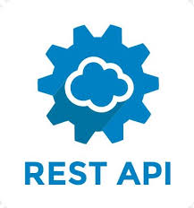
Any Server Admin Communication Options-
Is the server Java based ?
Out of the box management of the JVM
Pluggable/standard to most management agents, solutions
References many existing Java interfaces; JNDI, others
Standard NetBeans IDE interface
Many existing clients
(others)
Notes:
Source Url,
https://docs.oracle.com/javase/tutorial/jmx/overview/why.html
Why Use the JMX Technology?
The JMX technology provides developers with a flexible means to instrument Java technology-based applications (Java applications), create smart agents, implement distributed management middleware and managers, and smoothly integrate these solutions into existing management and monitoring systems.
The JMX technology enables Java applications to be managed without heavy investment.
A JMX technology-based agent (JMX agent) can run on most Java technology-enabled devices. Consequently, Java applications can become manageable with little impact on their design. A Java application needs only to embed a managed object server and make some of its functionality available as one or several managed beans (MBeans) registered in the object server. That is all it takes to benefit from the management infrastructure.
The JMX technology provides a standard way to manage Java applications, systems, and networks.
For example, the Java Platform, Enterprise Edition (Java EE) 5 Application Server conforms to the JMX architecture and consequently can be managed by using JMX technology.
The JMX technology can be used for out-of-the-box management of the Java VM.
The Java Virtual Machine (Java VM) is highly instrumented using the JMX technology. You can start a JMX agent to access the built-in Java VM instrumentation, and thereby monitor and manage a Java VM remotely.
The JMX technology provides a scalable, dynamic management architecture.
Every JMX agent service is an independent module that can be plugged into the management agent, depending on the requirements. This component-based approach means that JMX solutions can scale from small-footprint devices to large telecommunications switches and beyond. The JMX specification provides a set of core agent services. Additional services can be developed and dynamically loaded, unloaded, or updated in the management infrastructure.
The JMX technology leverages existing standard Java technologies.
Whenever needed, the JMX specification references existing Java specifications, for example, the Java Naming and Directory Interface (J.N.D.I.) API.
The JMX technology-based applications (JMX applications) can be created from a NetBeans IDE module.
You can obtain a module from the NetBeans Update Center (select Tools -> Update Center in the NetBeans interface) that enables you to create JMX applications by using the NetBeans IDE. This reduces the cost of development of JMX applications.
The JMX technology integrates with existing management solutions and emerging technologies.
The JMX APIs are open interfaces that any management system vendor can implement. JMX solutions can use lookup and discovery services and protocols such as Jini network technology and the Service Location Protocol (SLP).

Slide 6
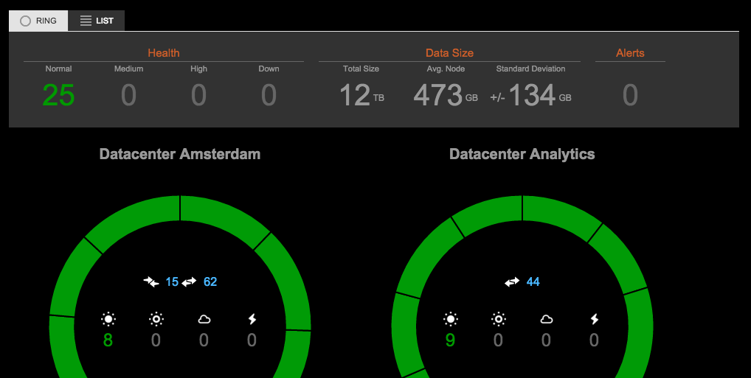
Getting (JMX like) data from DSE-
DSE Ops Ctr; Web, GUI
nodetool; reports on one node, command line, ASCII text
dsetool
CQL/System tables; Global (cluster wide view)
JMX
-- Programmatic, customizable
-- Default install is local only,
easily remote (security)
Notes:
There are many ways to get similar data out of DSE:
Ops Center, with its Web UI
nodetool, local to one node, command line, character based (could be viewed as formatted, and also not formatted (not JSON, similar)
dsetool
CQL queries of the system tables, a cluster wide view (generally)
JMX, programmatic, customizable, can hit remote nodes when configured

Slide 7
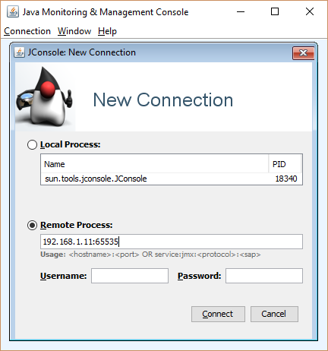
JMX, MBeans
JMX: Java Management Extensions, standard way to manage a Java application
Mbeans: Management Beans
-- Provided by the application
-- Attributes, can get() or set()
-- Operations, can invoke
-- Read and write
Many client programs
Notes:
JMX offers both a read and write interface into DSE.
Reference Urls,
https://en.wikipedia.org/wiki/Java_Management_Extensions

Slide 8
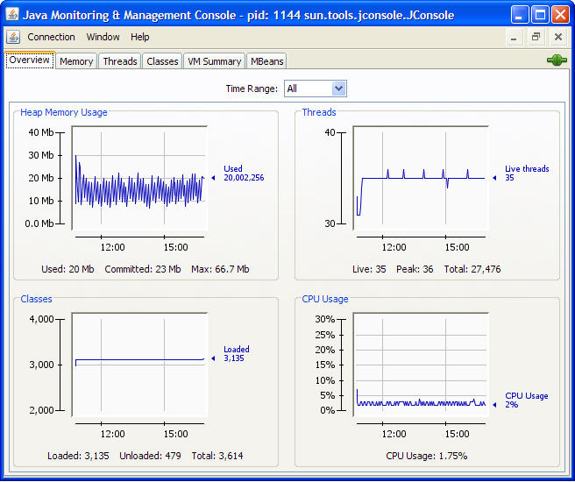
JMX Clients: (many)
nodetool, 80+ options, but formatted, documented, supported
nodetool sjk
JConsole
-- In Java SDK since 1.5
-- GUI, graphs too
mx4j, JMX via Http
Jolokia, JMX via Http/JSON
jmxsh, command line (REPL)
jmxterm, command line
VisualVM
Notes:
Reference Urls,
https://support.datastax.com/hc/en-us/articles/204226049-Using-JMX-Clients-with-Apache-Cassandra
https://en.wikipedia.org/wiki/Jconsole
https://docs.oracle.com/javase/8/docs/technotes/guides/management/jconsole.html
http://jolokia.org
http://github.com/davr/jmxsh
http://wiki.cyclopsgroup.org/jmxterm/download.html
https://visualvm.github.io/releases.html
https://docs.datastax.com/en/dse/5.1/dse-admin/datastax_enterprise/tools/nodetool/toolsSjk.html
nodetool specific
https://docs.datastax.com/en/dse/6.0/dse-admin/datastax_enterprise/operations/opsMonitoring.html

Slide 9
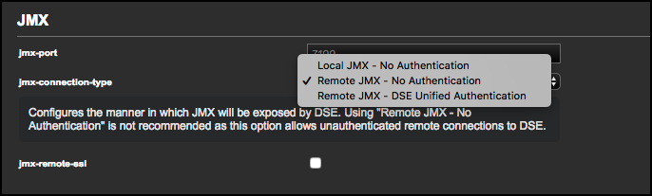
Securing (DSE) JMX-
Via Ops Center
Or Manually
Super important
-- Consider mandatory for production
-- And when allowing
remote clients
Notes:
Reference Urls,
https://docs.datastax.com/en/dse/6.0/dse-admin/datastax_enterprise/security/secEnableJmxAuth.html
https://docs.datastax.com/en/dse/6.0/dse-admin/datastax_enterprise/security/secMbeansAbout.html
https://docs.datastax.com/en/opscenter/6.5/opsc/LCM/opscLCMconfigJMXConnection.html

Slide 10
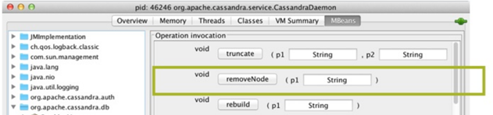
Why Secure JMX ?
Notes:
A reminder; JMX is not read-only. JMX provides access to the management layer of DSE. You can truncate tables, remove nodes, other.
JMX is the exact means by which nodetool and DSE Ops Center manage (change) the DSE cluster.

Slide 11
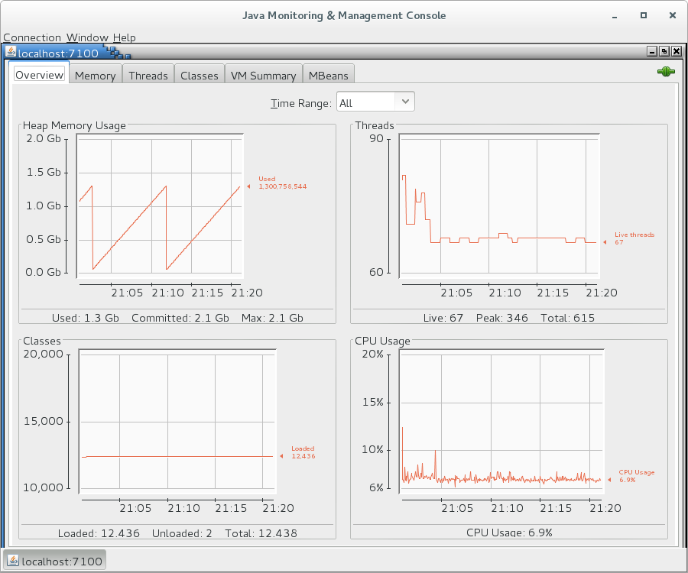
Using JConsole: jconsole localhost:7100
6 TABs
Read/write, graphs
MBeans TAB most expansive
Notes:
On a default DSE installation, the JMX interface is available at, localhost:7199
JConsole is installed by default with the Java SDK.

Slide 12

DSE MBeans
org.apache.cassandra.db
caching, table metrics, compaction, ..
org.apache.cassandra.internal
internal server operations; gossip, hinted
handoff, ..
org.apache.cassandra.metrics
client read/write request latencies, Bloom
filter false positives, ..
org.apache.cassandra.net
inter-node comm; StreamingService,
MessagingService, FailureDetector , ..
org.apache.cassandra.request
Tasks related to; read, write, replication, ..
org.apache.cassandra.service
Data about; node, ring, tokens, snapshots, ..
Notes:
Reference Urls,
https://www.datastax.com/dev/blog/metrics-in-cassandra12

Slide 13
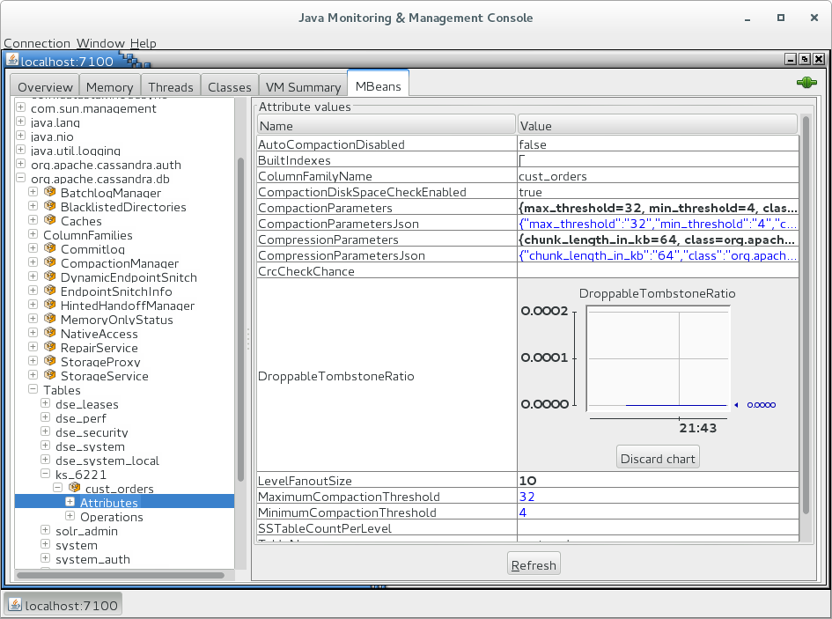
JConsole/ MBean Examples: Tombstones
Higher ratio is worse
Notes:
JConsole/MBean example:
org.apache.cassandra.db/Tables/(keyspace)/(table)/Attributes

Slide 14
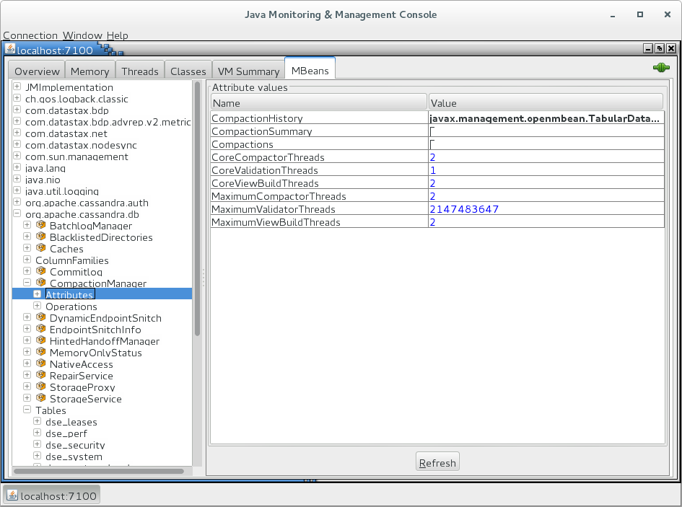
JConsole/ MBean Examples: Compaction
Throttling,
MaximumCompactorThreads
CoreCompactorThreads
Notes:
JConsole/MBean example:
org.apache.cassandra.db/CompactionManager/Attributes

Slide 15
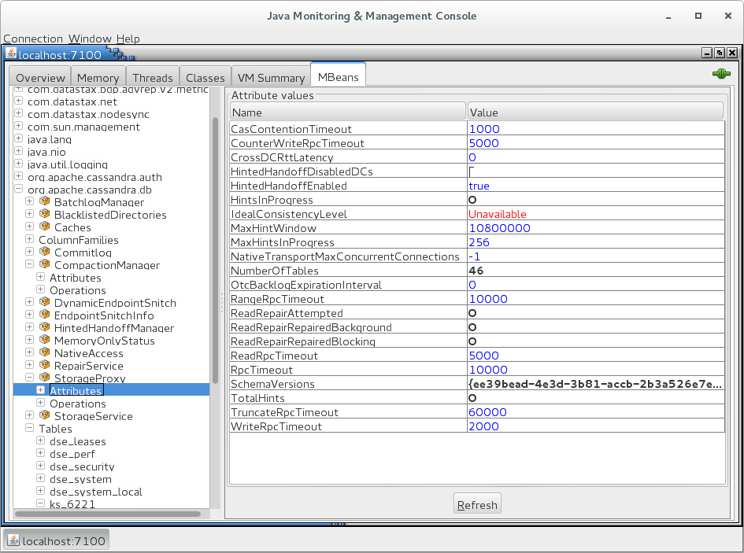
JConsole/ MBean Examples: Hinted Handoff
3 Hours by default, in milliseconds
MaxHintsInProgress
Notes:
JConsole/MBean example:
org.apache.cassandra.db/StorageProxy/Attributes

Slide 16
JConsole/ MBean Examples: (Time outs)
RangeRpcTimeout
(range queries)
ReadpcTimeout
(single read op)
RpcTimeout
(misc inter-node ops)
WriteRpcTimeout
(write ops)
TruncateRpcTimeout
(truncates)
Notes:
JConsole/MBean example:
org.apache.cassandra.db/StorageProxy/Attributes

Slide 17

But really: Use nodetool
nodetool info
Heap and off heap memory, key cache hit
rate
nodetool compactionstats
Status, volume, in-flight
nodetool tablestats
Index summary usage, memtable usage,
read/write latency, partition size,
tombstones per read
nodetool tablehistograms
Table access read/write latencies
nodetool proxyhistograms
Network read/write latencies
Source: https://www.pecheur.com/en/ie/buy-node-tool-stonfo-64402.html
Notes:
Reference Urls,
https://docs.datastax.com/en/dse/6.0/dse-admin/datastax_enterprise/tools/nodetool/toolsNodetool.html

Slide 18
Notes:
End of Discussion Module-

